Slide 1
SVM

Slide 2
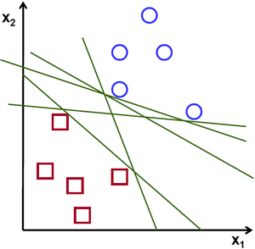
Which is the “best” Perceptron!

Slide 3
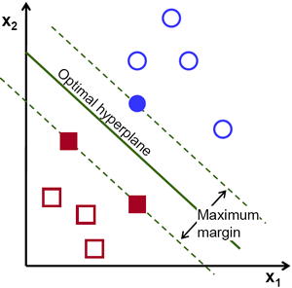
The “Best” Separation Boundary

Slide 4
Linear Support Vector Machines

Slide 5
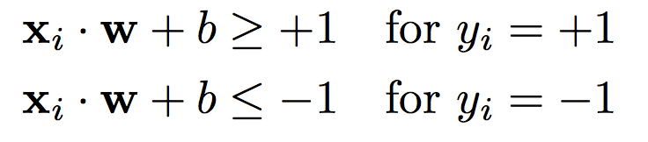

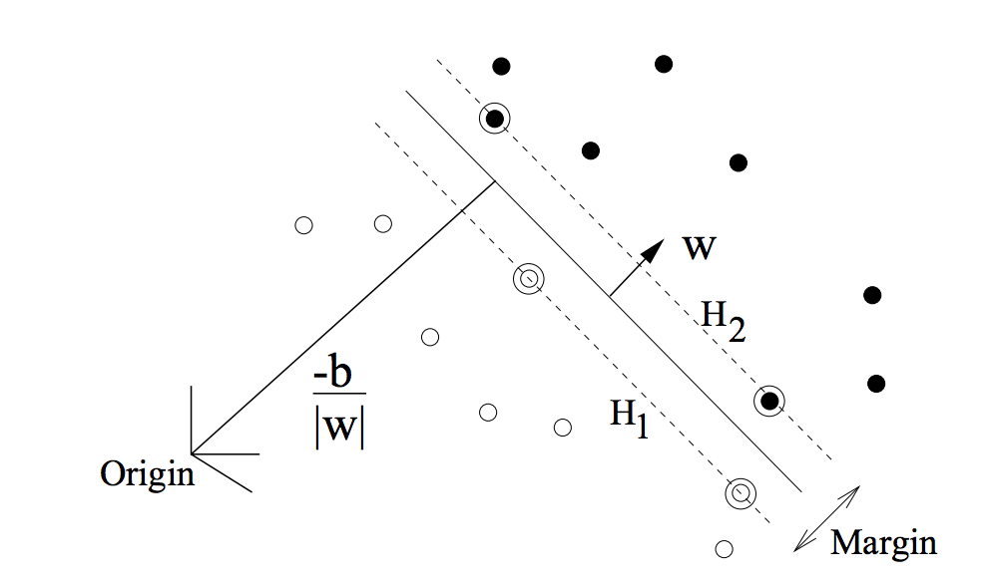
Linear Hyper-plane for 2-classes

Slide 6


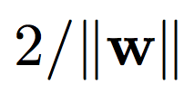
Linear Hyper-plane for 2-classes

Slide 7
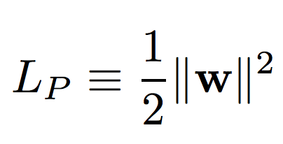
SVM Objective
OBJECTIVE:
CONSTRAINT:

Slide 8
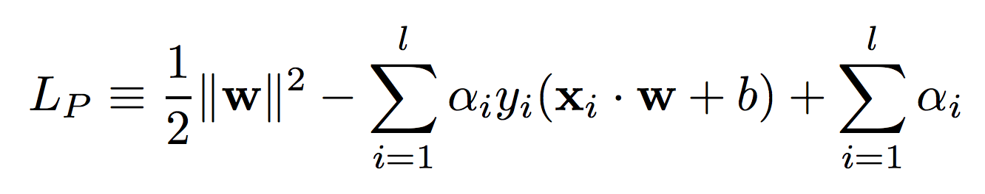
SVM Objective
OBJECTIVE:
CONSTRAINT:
Lagrange Multipliers

Slide 9
SVM Trick – 1 PRIMAL → DUAL

Slide 10
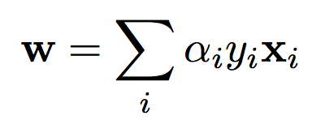
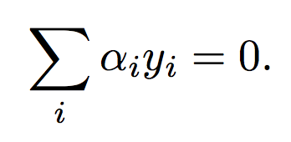
Solving the PRIMAL

Slide 11
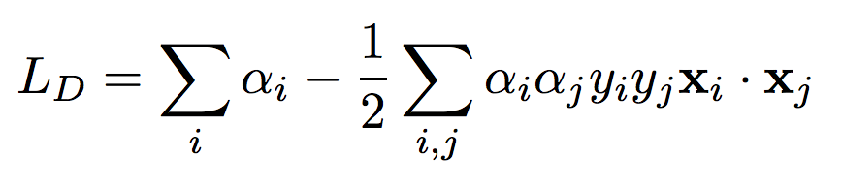
PRIMAL → DUAL

Slide 12
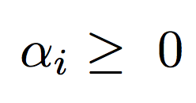
SVM Objective (DUAL)
OBJECTIVE: Minimize
CONSTRAINT:

Slide 13
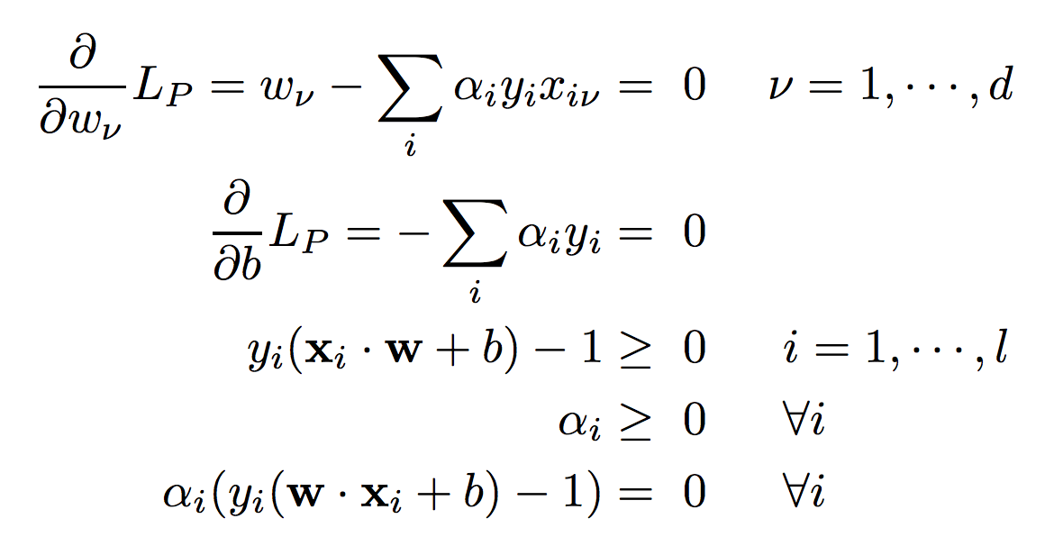
Karush-Kuhn-Tucker (KKT) condition

Slide 14
Support Vectors
Support Vectors

Slide 15
SVM Trick – 2 SLACK VARIABLES

Slide 16
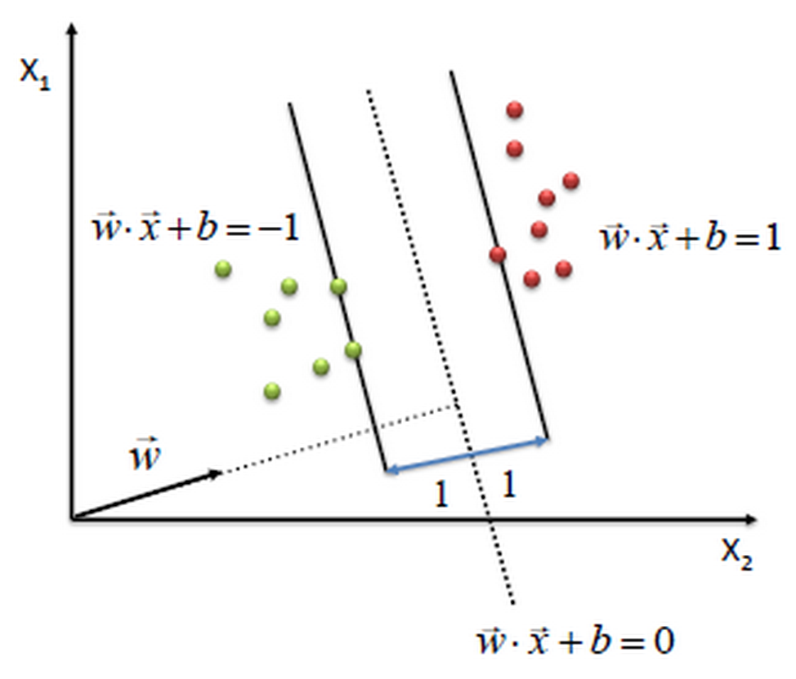
Separable Case

Slide 17
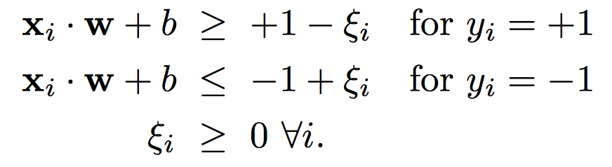
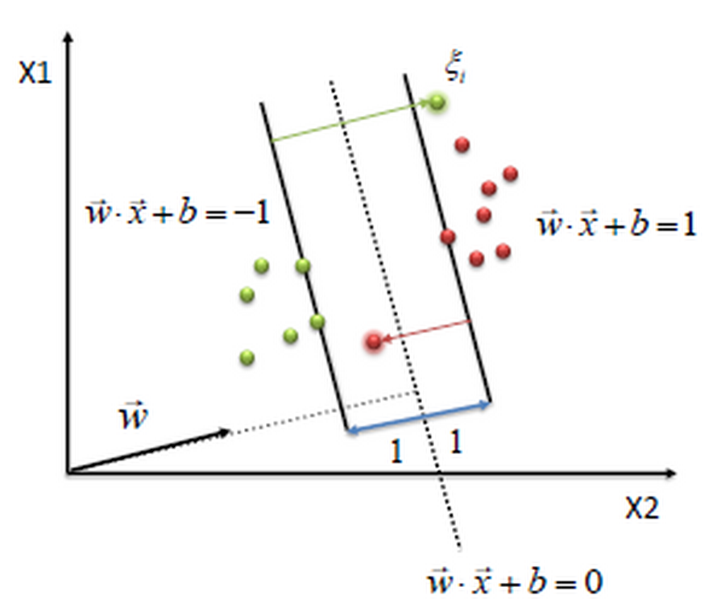
Non-Separable
Slack Variables

Slide 18
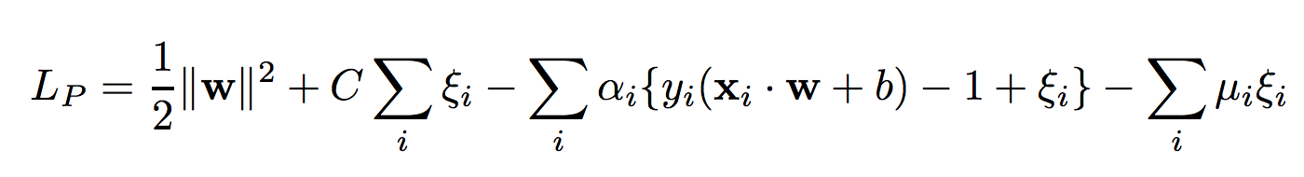
PRIMAL Objective
LINEARLY SEPARABLE CASE
LINEARLY NON-SEPARABLE CASE

Slide 19

DUAL Objective
LINEARLY SEPARABLE CASE
LINEARLY NON-SEPARABLE CASE

Slide 20
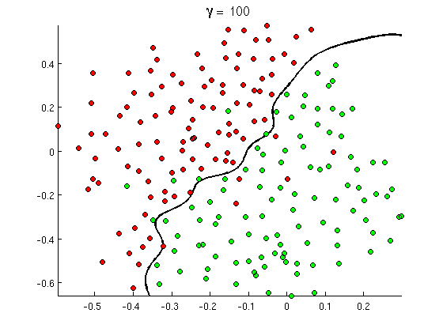
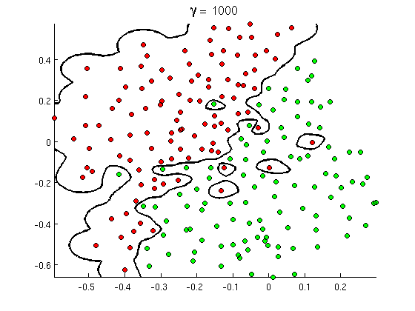
Tolerance for Slack → SVM Complexity

Slide 21
SVM Trick – 3 KERNEL TRICK

Slide 22
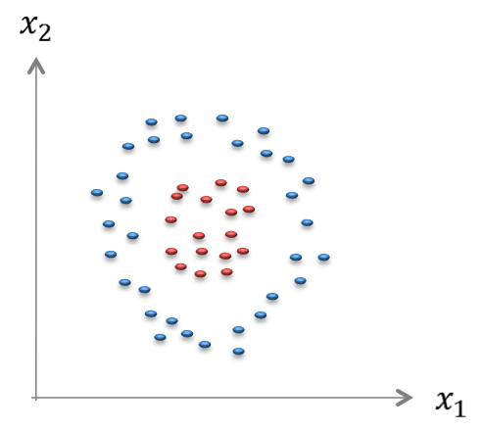
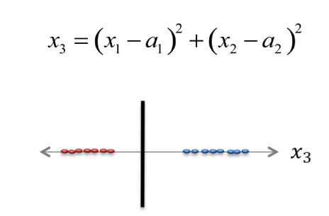
Feature Space Transformation
ORIGINAL FEATURE SPACE
Classes NOT LINEARLY SEPARABLE
TRANSFORMED FEATURE SPACE
Classes are LINEARLY SEPARABLE

Slide 23
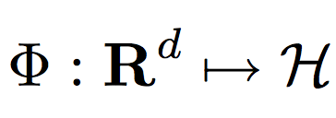
Increasing Model Capacity
LINEAR CLASSIFIERS
GENERALIZED LINEAR CLASSIFIERS

Slide 24
KERNEL TRICK

Slide 25
SVM Kernels
KERNEL FUNCTION

Slide 26
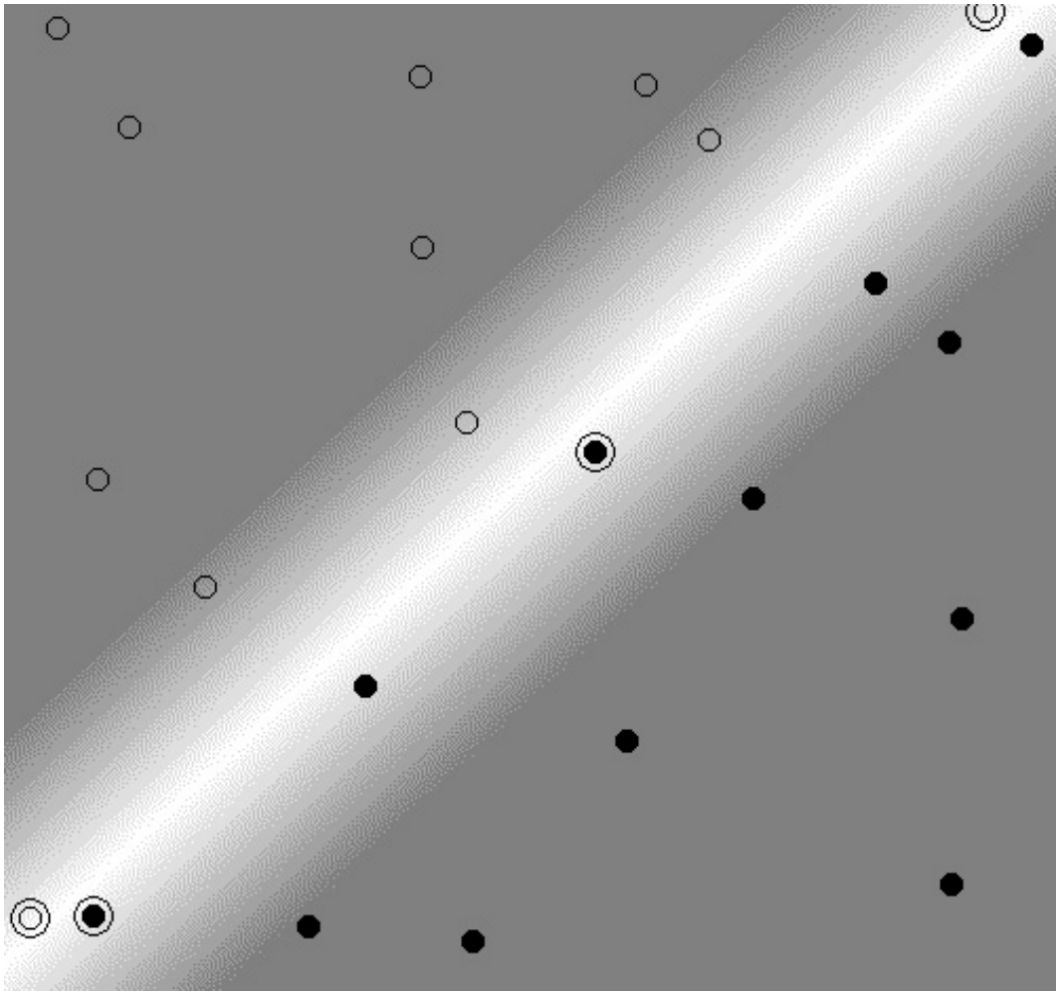
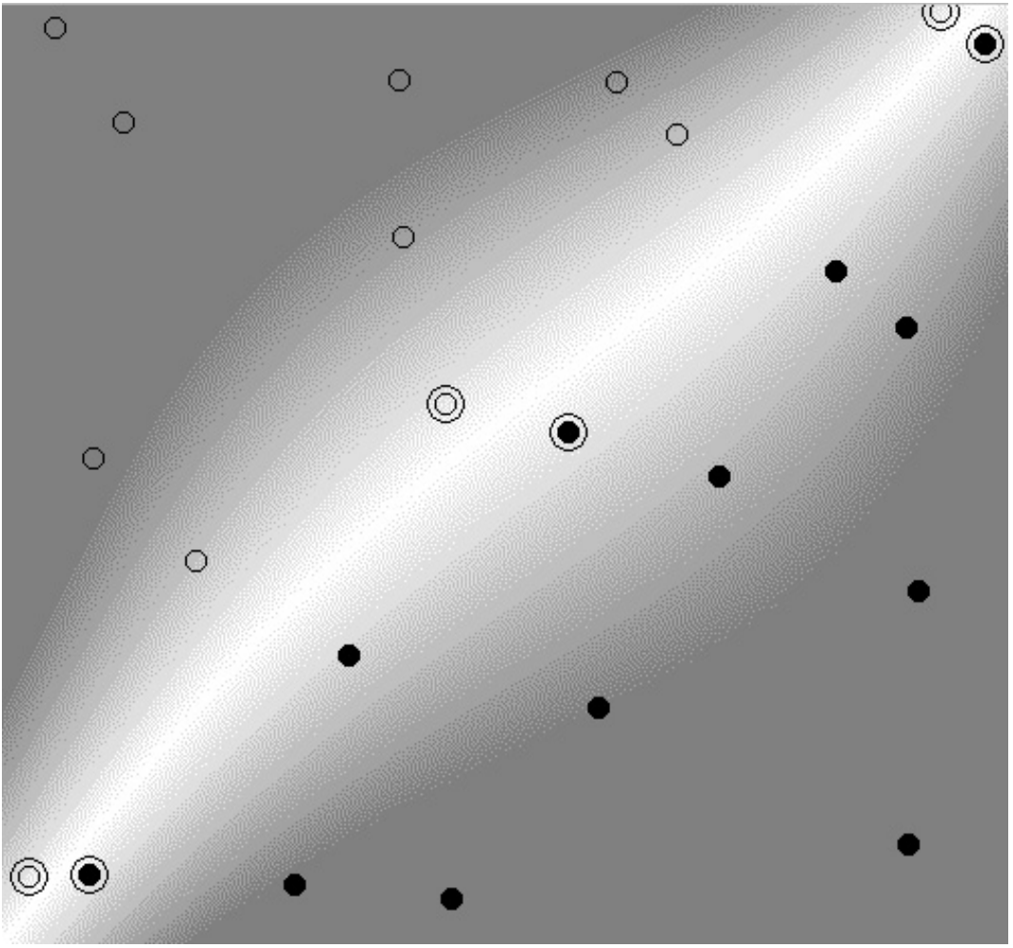
Polynomial Kernel / Separable

Slide 27
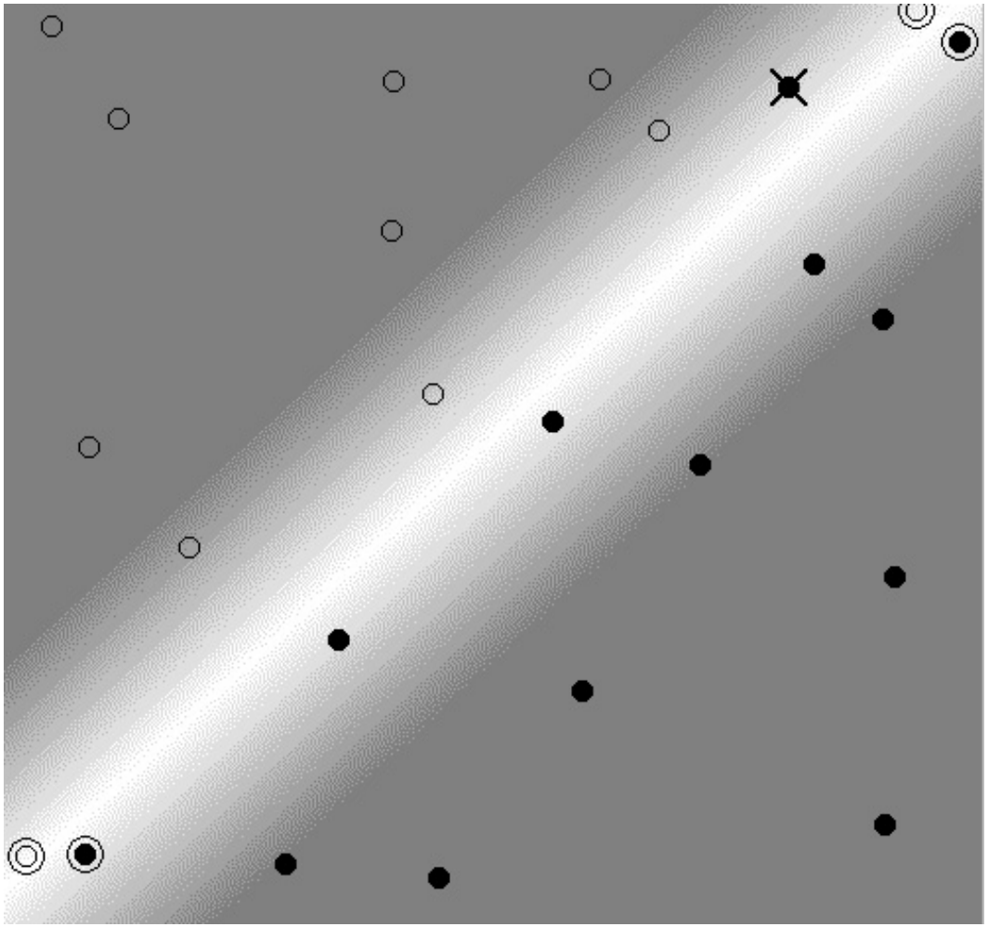
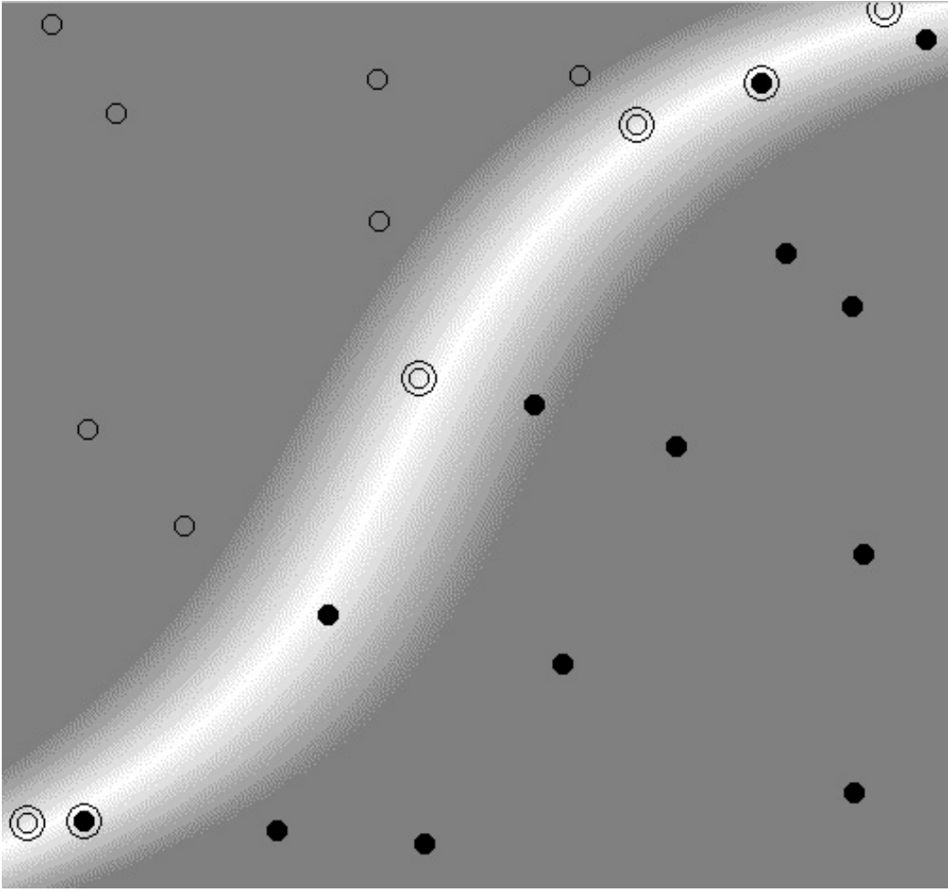
Polynomial Kernel / Non-Separable

Slide 28
Polynomial Kernel

Slide 29
RBF Kernels

Slide 30
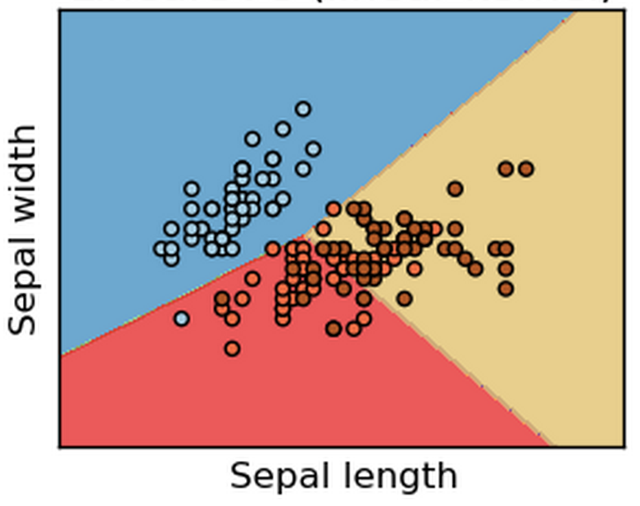
Linear SVM

Slide 31
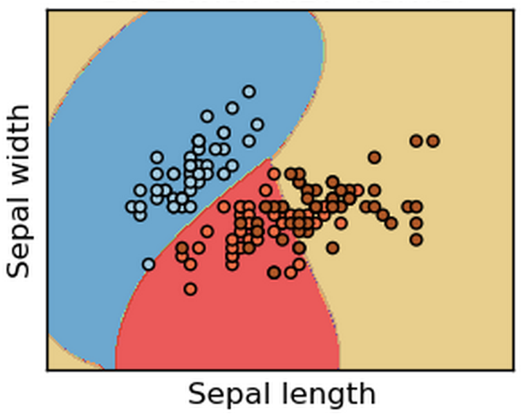
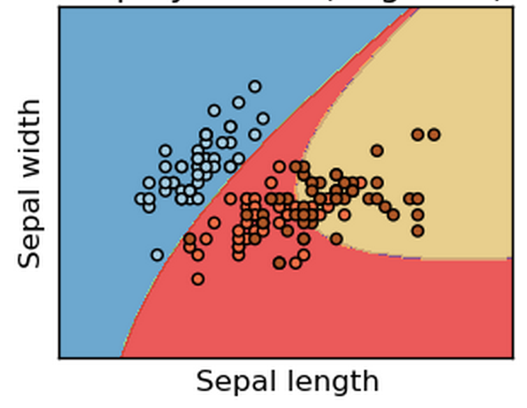
Non-Linear SVM

Slide 32
Summary in SVM
Learning an SVM Classifier
Trick 1 : PRIMAL → DUAL (Support Vectors)
Trick 2 : SLACK Variables
Trick 3 : Kernels
What kind of model is this?
What is the model?
What are the parameters?
What is complexity?
SCORING using SVM Classifier

Slide 33
Advanced Topics in SVM
More Kernels
Fisher Kernel
String Kernel
…
More Applications
SVM Regression
SVM based Outlier Detection
...
More Theory
VC Dimension
Probably Approximately Correct
…

